Slide 1






P R E S E N T A T I O N
2 0 2 6
Student Name
Anushree Bhatnagar
Student Email
bhatnagaranushree16@gmail.com
Mentor Name
Uma Maheswari

Slide 2
Academic Resource Optimization Dashboard

Slide 3

Outline
Abstract of the Project
Problem Statement
Proposed Solution
System Architecture
Live Demo of the Project
Embedded Video of Project
Conclusion
Future Scope

Slide 4
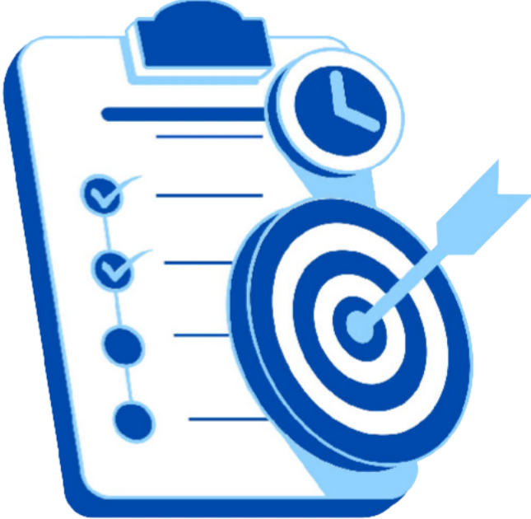
Abstract
Overview: AI-driven identification of resource-constrained students.
Objective: Mapping resource gaps to performance for targeted aid.
Tech Stack: Excel (Data) + Google Gemini (Logic).
Outcome: Real-time risk alerts and predictive grade modeling.
Key Highlight:
- Actionable Impact: Instant "Intervention Lists" for immediate student support.

Slide 5

Problem Statement
Problem: Tech scarcity causing underperformance.
Goal: To transform academic data into insights for data-driven decisions.
Target: To build a dashboard that helps identify student performance trends and resource needs.
Gap: Manual tracking lacks objective proof.
Scope: 500-student attendance & grade analysis.

Slide 6

Proposed Solution
Approach: AI-Excel dashboard mapping the "Digital Divide."
Method: Ai-powered risk tiering for 500 students.
Solution: Dynamic visuals replacing manual tracking.
Innovation: Automated student risk classification using AI.
ROI: Better resource allocation through data insights.

Slide 7
System Architecture
Data Input / Source
Processing / Analysis
Ingesting 500 student profiles; using attendance as a hardware/internet reliability proxy.
Utilizing Excel VLOOKUPs and Pivot Tables to isolate performance gaps.
AI / Tool Integration
Output / Dashboard
Gemini-architected nested IFS logic for automated, unbiased risk tiering.
Visual proof of the "Digital Divide" with a targeted 38-student intervention list.

Slide 8
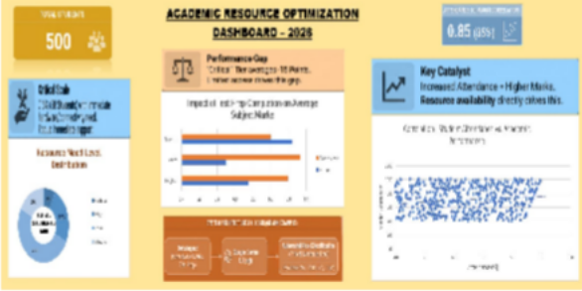
Live Demo of Project
Here's the list of some demo screenshots / features of the project:
Github Repository
Repo Link :- anushreebhatnagar/student- resource-optimization-dashboard: An AI-architected data engine to identify student vulnerabilities due to the digital divide
Video Presentation
Link :- https://drive.google.com/file/d/1r sfgWNEqscs1tEyo-FiAfv- WbBLevHEK/view?usp=drivesdk
Dashboard

Slide 9




▶
Video of Project Demo
[https://your-project-demo-link.com]
[Insert your project demo video.
You can embed a video your live project.]

Slide 10

Conclusion
Accomplished: AI dashboard replacing manual resource tracking.
Key Finding: Proved tech access drives attendance and academic success.
Impact: Eliminated equity guesswork; enabled hardware for 38 high-need students.

Slide 11
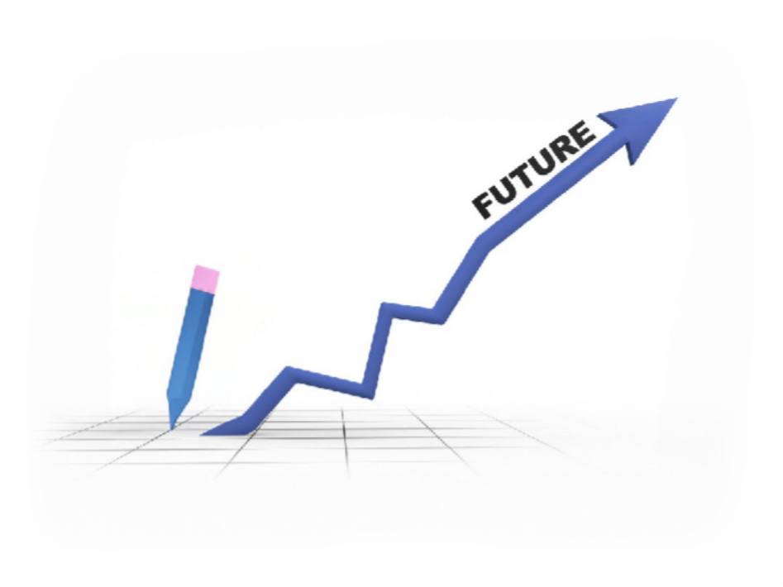
Future Scope
Next Steps: Transitioning to live LMS integration via API.
Predictive AI: Forecasting early dropout risks using ML.
Automation: Trigger-based funding for "Critical" tier students.
Long-Term Impact: Scaling methodology to close the global Digital Divide.

Slide 12
Thank You
A I C W F e l l o w s h i p | S t u d e n t P r o j e c t P r e s e n t a t i o n 2 0 2 6
LinkedIn | Edunet Foundation

